Slide 1
An Approach for Construction of Indoor Floor Plan and Localization using Wi-Fi and Smartphone (published at IEEE WoWMoM 2014 and accepted to ACM Wireless Networks)
Ahmad Abadleh, Myungchul Kim, and et al.

Slide 2
Outline
Introduction
Related Work
Problem Statement
The Proposed Approach
Implementation and Result Analysis
Conclusion and Future Work

Slide 3
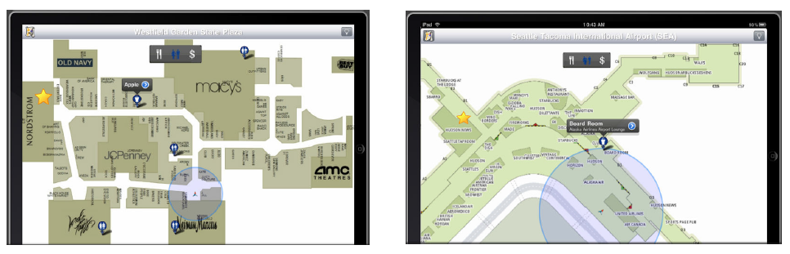
Introduction
People spend most of their time indoors, e.g., shopping malls, libraries, airports, university campuses [1]
Massive availability of mobile devices with wireless connectivity
GPS signals are unavailable and infeasible in indoor environment [1]
Interest in indoor location-aware applications, e.g., in-building guidance, asset tracking, event detection
User Position in a Shopping Mall
User Position in an Airport
2
39

Slide 4
Related Work (1)
Trilateration [3]
The user’s position is detected as the intersection point between three circles
To make the circles, the distance from three APs should be computed
Time of Arrival (TOA) : converting the time to distance
Received Signal Strength (RSS): converting the signal to distance
User’s position
3
39

Slide 5
Related Work (2)
Trilateration needs distance and angle measurements, but no accurate distance or angle estimation found due to multipath problem
Multipath problem
4
39

Slide 6
Related Work (3)
Fingerprinting [4]
The building is divided into grids
Offline Phase: used to build the database (radio map) by computing the average RSS in each grid
Online Phase: used to detect the user’s position by comparing the online RSS measurement with the database
Offline Phase
Online Phase
5
39

Slide 7
Related Work (4)
Fingerprinting depends on radio map
This technique suffers from signal attenuation, therefore, the database needs recalibration frequently
6
39

Slide 8
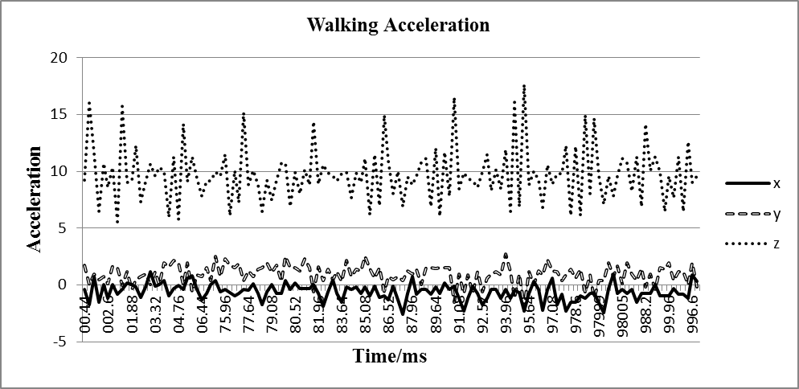
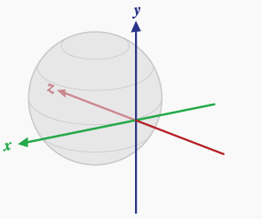
Related Work (5)
Smartphone Based Approaches[1, 2]
Smartphone sensors are used to detect the distance and the direction
Accelerometer: used to compute the distance
Digital Compass: used to compute the direction
Smartphone based approaches which rely on sensors suffer from noisy sensors
Distance estimation
Noisy sensors
Direction estimation
7
39

Slide 9
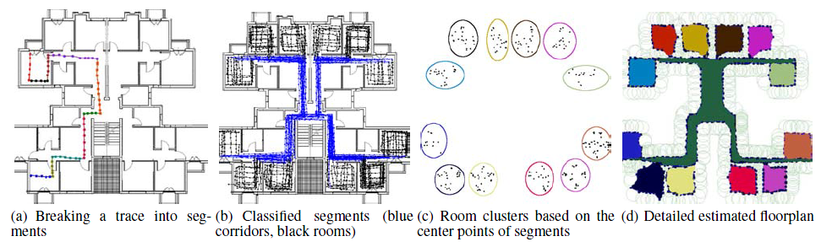
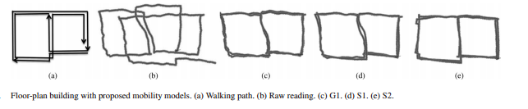
Related Work (6)
Floor Plan Construction
Crowdsource [10]: building the floor plan by equipping the users’ phone by an application which gathers information during their daily life
Crowdsource violates the privacy, since it needs an application to be downloaded on users’ phone to gather some information during the daily life
Smartphone Based Approach [11]: smartphone sensors are used to detect the floor plan
Smartphone sensors approaches can’t detect the floor plan components, such as rooms since they only focus on one path
Crowdsource
Smartphone Sensors
8
39

Slide 10
Problem Statement
Our approach has to address the following limitations in the existing work
The distance is a critical factor in indoor localization because it affects the accuracy of the system. However, the distance estimation is still inaccurate
The time consuming to build and rebuild the database due to signal attenuation is an important problem
The lack of the indoor floor plan is a problem because most of the indoor localization approaches need it
9
39

Slide 11
The Proposed Approach Overview (1)
The proposed approach has the following phases
Phase 1: Floor Plan Construction
Phase 1.1 Divide the building into sections
Phase 1.2 Detect the position of the APs and mark them as reference points
Phase 2: Localization
Phase 2.1 Detect the position of the user when a reference point is detected
Phase 2.2 Track the user according to the smartphone sensors
Phase 3: Feedback System
Phase 3.1 Keep track of the users’ trajectories, and use them later to create the indoor floor plan
10
39

Slide 12
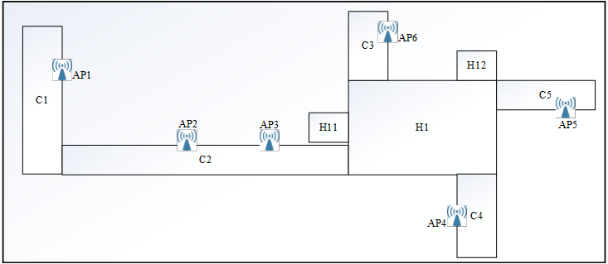
The Proposed Approach Overview (2)
Phase 1: Floor Plan Construction
Phase 1.1 Sections
Phase 1.2 Reference points
Phase 2: Localization
Phase 2.1 User’s position
Phase 2.2 Tracking
Phase 3: Feedback
Phase 3.1 User’s trajectory
Main Idea: Public APs act as reference points
User’s position is detected and used the closest reference point
User’s position, distance, and direction are adjusted each time the user encounters a reference point
11
39

Slide 13
System Architecture
Assumptions
The building has a number of public APs (most of the building has Wi-Fi; therefore, this assumption is valid)
The server has the APs’ MAC addresses table
The user holds the phone by hand
12
39

Slide 14
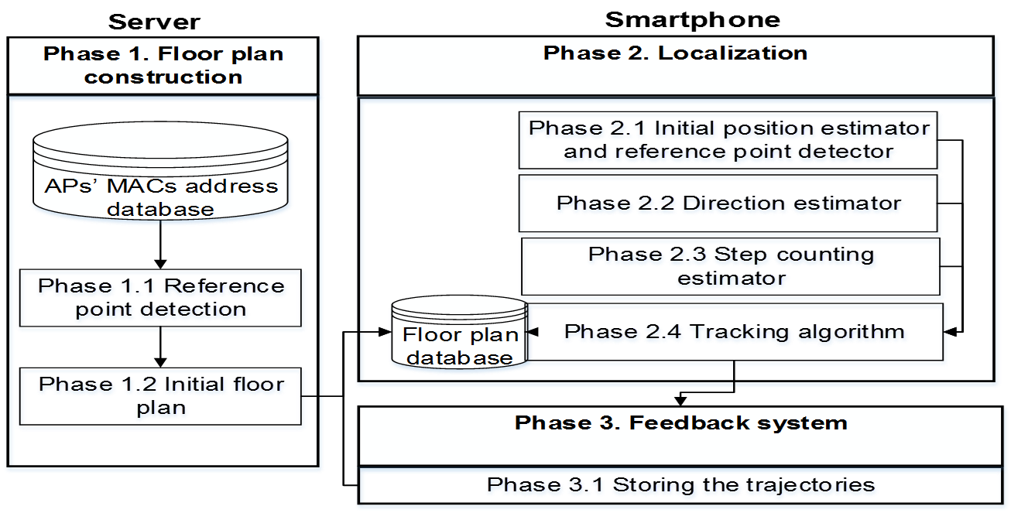
Phase 1. Floor Plan Construction
APs’ MACs address database should be given by the network administrator
Phase 1.1 The user needs to survey the building twice by walking two times in the floor. In the meanwhile, the system generates the position of the reference points
Phase 1.2 While the user is walking in the building, the system stores his/her trajectories to build the floor plan
13
39

Slide 15
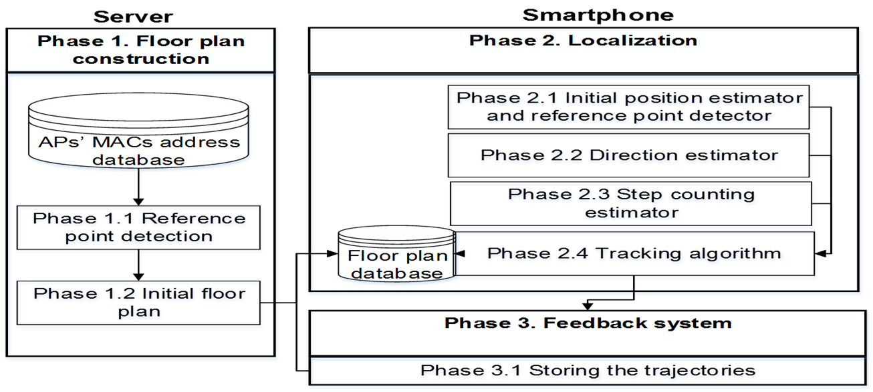
Phase 1. Floor Plan Construction
14
39

Slide 16
Phase 1.1. Reference Point Detection
To detect the position of the reference points, the user survey the building twice by walking in the building two rounds
Round one is to determine the RSS threshold for each reference point. To do so, the RSS values are obtained by surveying the floor along a path that the user traverses. Then the system calculates the average RSS values for every time window (e.g., 2 seconds) and stores the RSS values in the server
Round two is to detect the position of each AP. The position of the AP is detected by computing the RSS average every time window surpassing the RSS threshold, then the position is detected if the strongest RSS average is determined.
15
39

Slide 17
Phase 1. Floor Plan Construction
16
39

Slide 18
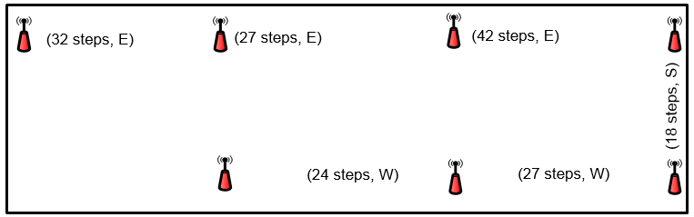
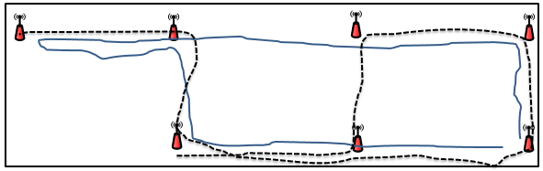
Phase 1.2. Initial Floor Plan
Algorithm
Initial floor plan consists of multiple paths
Each path consists of multiple points
Each point consists of RSS, acceleration, and orientation values
If (new reference point is detected)
If (Time < TimeWindow) {
Steps = DetectSteps (acceleration)
Direction = DetectDirection (orientation)
RSSAverage = DetectRSSAverage (RSS)
} else {
Insert into database (Steps, Direction, RSSAverage)
Reset (Steps, Direction, RSSAverage)
}
Path 1
A point is drawn every time window
17
39

Slide 19
Phase 2. Localization
Phase 2.1 The initial position is detected using the nearest reference point
Phase 2.2 Direction is estimated using the digital compass
Phase 2.3 Step counting is used to compute the distance using the accelerometer
Phase 2.4 Tracking algorithm is used to adjust the user’s position, correct the distance and direction each time a user encounters a reference point
18
39

Slide 20
Phase 2. Localization
19
39

Slide 21
Phase 2.1. Initial Position Estimator (1)
The regression example for three APs shows that the R² average for the three APs is about 0.7
This implies that the negative correlation between distance and RSS is about 70%
The relationship between RSS and distance
Observation: RSS can be used to as an indicator for the distance
20
39

Slide 22
Phase 2.1. Initial Position Estimator (2)
The system observes the RSS average until it detects the peak value
To avoid adjusting the position based on the local maximum, the system tracks the maximum average for the last two continuous windows when the average begins to decrease
Global MAX: the maximum RSS average peak
Local MAX: a RSS average peak
21
39

Slide 23
Phase 2. Localization
22
39

Slide 24
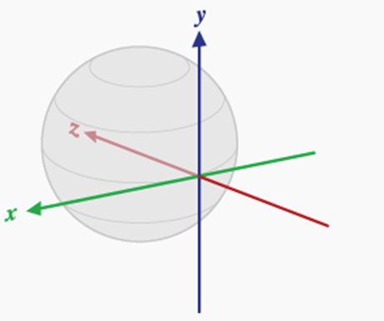
Phase 2.2. Direction Estimator
The direction of the user needs to be estimated after deciding its initial position, and this will be used as an indicator for the next building section that the user is heading towards
Direction is determined as follows:
Smooth the orientation data using low pass filter
Azimuth value is used to detect the direction
Azimuth Range | Direction
0 – 89 | North
90 – 179 | East
180 – 269 | South
270 – 359 | West
Azimuth
23
39

Slide 25
Phase 2. Localization
24
39

Slide 26
Phase 2.3. Step Counting Estimator
Peak detection algorithm (PDA) is used to detect the peak values in a dataset. It uses the acceleration values, which are derived from the accelerometer sensor to detect the distance.
The distance is computed by detecting the peak values from the acceleration, where each peak represents a step
Each peak represents a step
25
39

Slide 27
Phase 2. Localization
26
39

Slide 28
Phase 2.4. Tracking Algorithm
Tracking algorithm is responsible about tracking the user and adjusting the user position
If any reference point is detected, the tracking algorithm resets the distance and the direction
If the user enters an elevator, the tracking algorithm detects that by observing the RSS and acceleration values
RSS inside and outside an elevator
Acceleration in an elevator
27
39

Slide 29
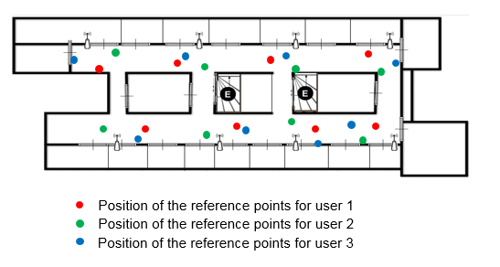
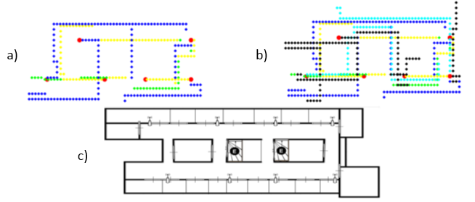
Phase 3. Feedback System
Feedback system is used to automatically update the database and enhance the accuracy of the floor plan by storing the users’ trajectories
Updating the position of the reference points
Updating the initial floor plan
28
39

Slide 30
Implementation and Results
Experimental environments:
N1 Building from 7th to 9th floors at KAIST
8 reference points each
Average distance between each two reference points is 17 m
Dimension: W: 30 m, L : 70 m
CS Building 1st and 2nd floors at KAIST
8 and 7 reference points respectively
Average distance between each two reference points is 20 m
Dimension: W: 60 m, L : 120 m
KI Building 1st floor at KAIST
2 reference points, we installed 3 more
Average distance between each two reference points is 20 m
Dimension: W: 85 m, L : 80 m
29
39

Slide 31
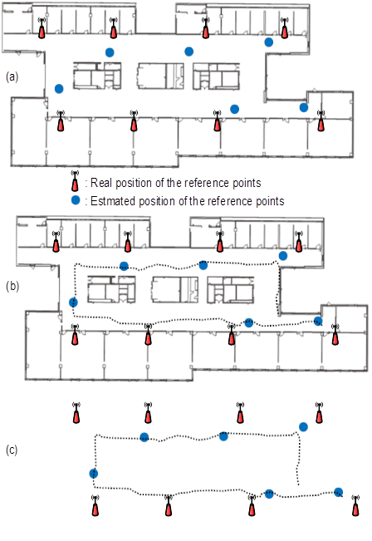
Phase 1. Floor Plan Construction (1)
Initial floor plan consists of positions of the reference points and the corridors layout
The proposed approach has the ability to detect most of the reference points with accuracy of 2 m to 3 m
Initial Floor Plan
Detecting Reference Point
Floor | No. of reference points | No. of detected reference points | Avg. error (m)
N1 9th F | 8 | 8 | 2.9
N1 8th F | 8 | 6 | 3
N1 7th F | 8 | 8 | 2.6
CS 1st F | 8 | 8 | 2.6
CS 2nd F | 7 | 6 | 2
KI | 5 | 5 | 2.9
30
39

Slide 32
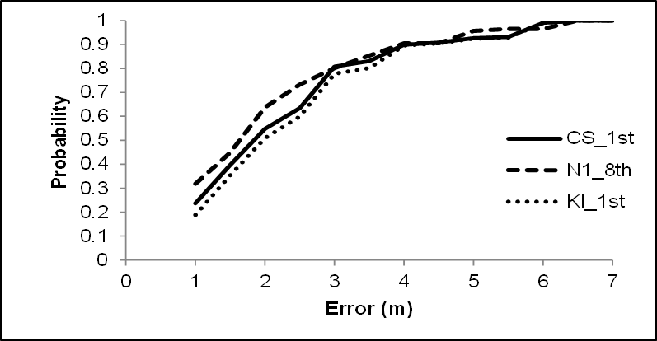
Phase 1. Floor Plan Construction (2)
Detecting the reference points within 5 m is 95%, 4 m is 90 %, and 3 m is 80%
The above confidence shows the feasibility of the proposed approach since the accuracy of detecting the reference points is promising and enough for detecting accurate floor plan
CDF of reference points detection error for the proposed approach
31
39

Slide 33
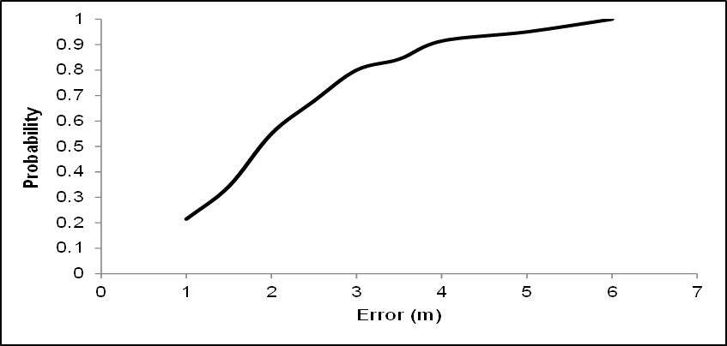
Phase 2. Localization (1)
The Mean Error and Standard Deviation
N1 Building: 2 m and 0.9 m, respectively
CS Building: 3 m and 1.1 m, respectively
Localization CDF of the proposed approach
The accuracy is 3.8 m for 90 % and 2.2 m for 60 % of both environments
The accuracy is practical and feasible for most of the indoor environments
32
39

Slide 34
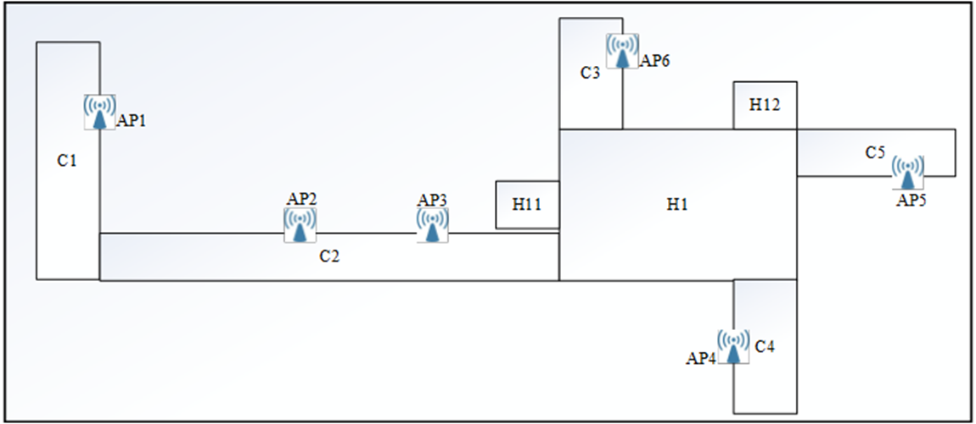
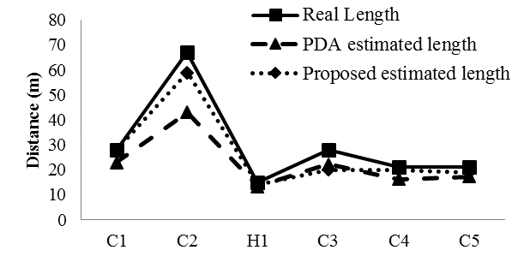
Phase 2. Localization (2)
The proposed approach overcomes the conventional PDA in term of accuracy in distance estimation
Section | Length (m) | Estimated length using PDA | Estimated length using the proposed approach
C1 | 28 | 23 | 28
C2 | 67 | 43 | 59
H1 | 15 | 13 | 14
C3 | 28 | 22 | 20
C4 | 21 | 16 | 20
C5 | 21 | 17 | 19
33
39

Slide 35
The Proposed Approach vs Fingerprinting Approaches(1)
We have compared our approached with the following fingerprinting approaches
ARIEL [7] : presents a technique to automatically detect the room fingerprints based on Wi-Fi signature during the offline phase
Peer Assistance [8]: presents an technique to detect the position of the user based on measured fingerprints and enhance the position detection using any existing users in the environment
RADAR [9]: one of the earliest and the most popular technique in fingerprinting, it builds the database from 70 marked places in the environment
34
39

Slide 36
The Proposed Approach vs Fingerprinting Approaches(2)
Approach | Database Size | Database Calibration | Energy and Time | Accuracy (m)
The proposed | < 30 Records | Automatically | Few seconds for localization, few minutes for surveying | 2 – 3
ARIEL | 193 positions X 20 measurements | Every few months | Few seconds for localization, few days for surveying | Room level
Peer Assistance | 131 positions X 20 measurements | Every few months | Few seconds for localization, few days for surveying | 2 – 3
RADAR | 70 positions X 30 measurements | Every few months | Few seconds for localization, few days for surveying | 3 – 5
35
39

Slide 37
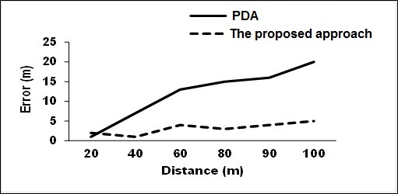
The Proposed Approach vs Smartphone Based Approaches
UnLoc [6]: correcting user positions based on landmarks (e.g., Wifi, elevator, …)
EZ [5]: detect the user position via genetic algorithm
System | Accuracy (m) | Advantage | Disadvantage
The Proposed Approach | 2 – 3 | Robust to any change in the environment | Needs reference point for initial position
EZ | 5 | No war-driving | Needs GPS
UnLoc | 1 – 2 | No war-driving | Needs door location
The proposed approach vs the conventional PDA
36
39

Slide 38
The Proposed Approach vs Indoor Construction Approaches
Crowdsource [10]: building the floor plan by equipping the users’ phone by an application which gathers information during their daily life
Smartphone Based Approach [11]: smartphone sensors are used to detect the floor plan
System | Advantage | Disadvantage
The Proposed Approach | Detecting all the indoor floor components | Needs two rounds offline to build the initial floor plan
Crowdsource [10] | Detecting all the indoor floor components | Privacy issue, Effort
Smartphone Based Approach [11] | Detecting the corridors’ layout | Can’t detect the rooms
37
39

Slide 39
Conclusion and Future Work (1)
Contributions
Enhancing the floor plan estimation by accurately detecting the position of the reference points
Improving the accuracy of position detection according to the reference points’ positions
Improving the accuracy of distance and direction estimation by correcting the distance and the direction using the reference points
Reducing the effort and the time to build and update the database
Our approach overcomes the existing approaches in term of accuracy and effort of building the database
The accuracy of detecting the reference points was 3 m, while the accuracy of the localization was 2 – 3 m
38
39

Slide 40
Conclusion and Future Work (2)
Future Work
In our approach, the user needs to be close to a reference point in order to detect his/her position. We will extend our approach to detect the initial position even if the user is far from a reference point
Also, our approach assumes that the user holds the phone by hand in order to detect accurate direction. We will extend our approach to provide the direction in any case even if the user does not hold the phone by hand
39
39

Slide 41
References
[1] Y. Chon and H. Cha, “LifeMap: Smartphone-Based Context Provider for Location-Based Services,” Proc. IEEE PerCom, pp. 58–67, 2011.
[2] Shanklin, T.A.; Loulier, B.; Matson, E.T.; , "Embedded sensors for indoor positioning," IEEE Sensors Applications Symposium (SAS), 2011.
[3] Z. Yang and Y. Liu, “Quality of Trilateration: Confidence Based Iterative Localization,” IEEE Trans. Parallel Distrib. Syst., vol. 21, no. 5, pp. 631–640, 2010.
[4] A. Matic, A. Papliatseyeu, V. Osmani, and O. Mayora-Ibarra, “Tuning to your Position: FM Radio Based Indoor Localization with Spontaneous Recalibration,” Proc. IEEE PerCom, pp. 153 - 161, 2010.
[5] K. Chintalapudi, A. Padmanabha Iyer, and V. N. Padmanabhan, "Indoor Localization Without the Pain," Proc ACM MobiCom, pp. 173-184, 2010.
[6] W. He, S. Souvik, E. Ahmed, F. Moustafa, Y. Moustafa, and R. R. Choudhury, “No Need to War-drive: Unsupervised Indoor Localization,” Proc. ACM MobiSys, pp. 197–210, 2012.
[7] Yifei Jiang, Xin Pan, Kun Li, Qin Lv, Robert P. Dick, Michael Hannigan, and Li Shang. “ARIEL: Automatic Wi-fi Based Room Fingerprinting for Indoor Localization,” Proc. ACM UbiComp, pp. 441–450, 2012.
[8] Hongbo Liu, Jie Yang, Sidhom S., Yan Wang, Yingying Chen, and Fan Ye, "Accurate WiFi Based Localization for Smartphones Using Peer Assistance," Mobile Computing, IEEE Trans. on , vol.13, pp. 2199 - 2214, 2014.
[9] Bahl, P.; Padmanabhan, V.N., "RADAR: an in-building RF-based user location and tracking system," IEEE InfoCom, 2000.
[10] M. Alzantot and M. Youssef, “Crowdinside: automatic construction of indoor floorplans,” ACM SIGSPATIAL , 2012.
[11] H. Shin, Y. Chon, and H. Cha, "Unsupervised construction of an indoor floor plan using a smartphone," IEEE Trans. Systems, Man, and Cybernetics, pp.889-898, 2012.

